Slide 1

FA541 Project HR attrition rate analysis and prediction Why workers quit?
JINXIN QU

Slide 2
Data Description
Sample Size: 1470 Workers
Dependent variable: Attrition (Categorical Variable, Yes = 1, No = 0)
Independent variables: Age, Business Travel, Daily Rate, Department, Distance From Home, Education, Education Field, Employee Count, Employee Number, Environment Satisfaction, Gender, Hourly Rate, Job Involvement, Job Level, Job Role, Job Satisfaction, Marital Status, Monthly Income, Monthly Rate, Num Companies Worked, Over18, Over Time, Percent Salary Hike, Performance Rating, Relationship Satisfaction, Standard Hours, Stock Option Level, Total Working Years, Training Times Last Year, Work Life Balance, Years At Company, Years In Current Role. Years Since Last Promotion, Years With Current Manager

Slide 3
Important Factors Cause Attrition - some guesses
Relevant Variables
Irrelevant variables (Drop)
Over18
Employee Count
Employee Number
Standard Hours (80 hours)
Ages
Income
Distance From Home
Environment Satisfaction & Job Satisfaction
Marital Status
Work Life Balance
Gender
30 independent variables

Slide 4
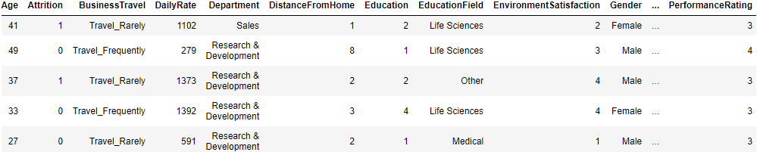
How the data looks like

Slide 5
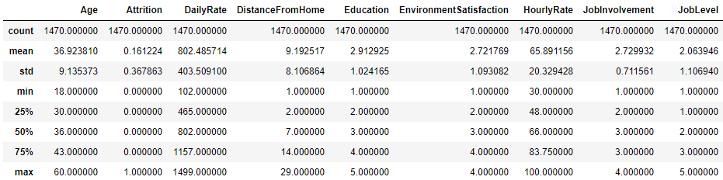
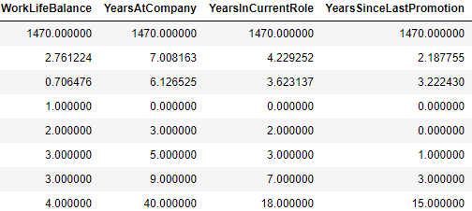
Statistics

Slide 6
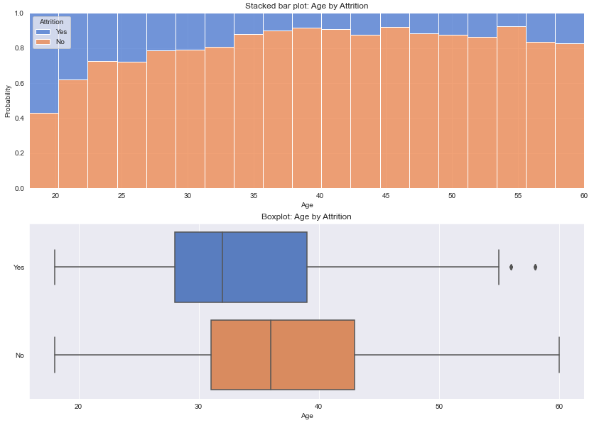
Exploratory Analysis - How is attrition dependent on Ages
Corr = -0.159

Slide 7
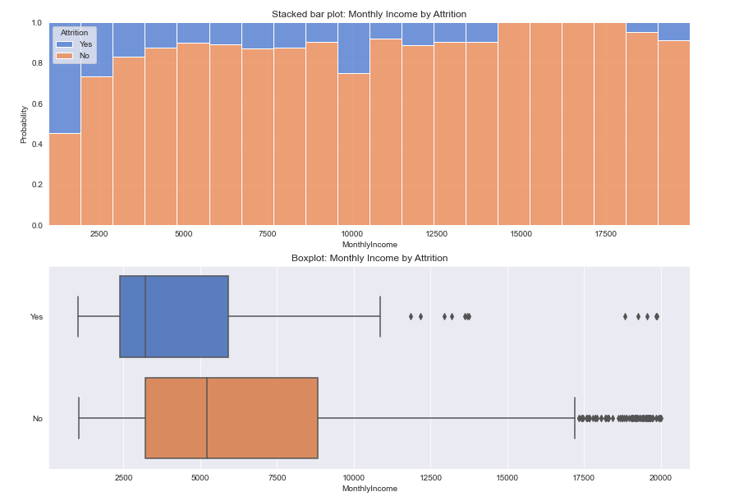
Exploratory Analysis - How is attrition dependent on Income
Corr = -0.16

Slide 8
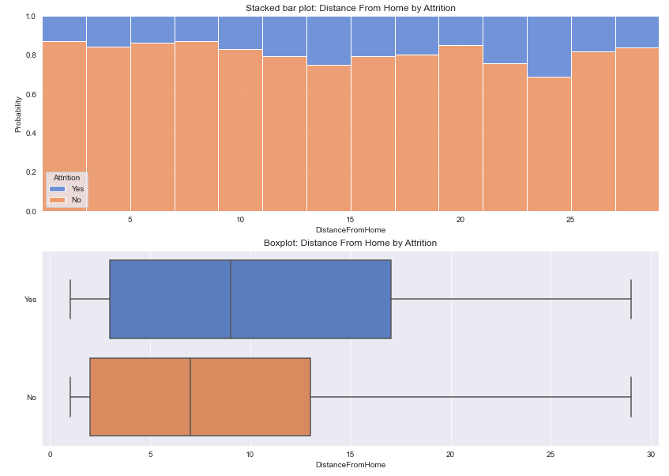
Exploratory Analysis - How is attrition dependent on Distance from Home
Corr = 0.078

Slide 9
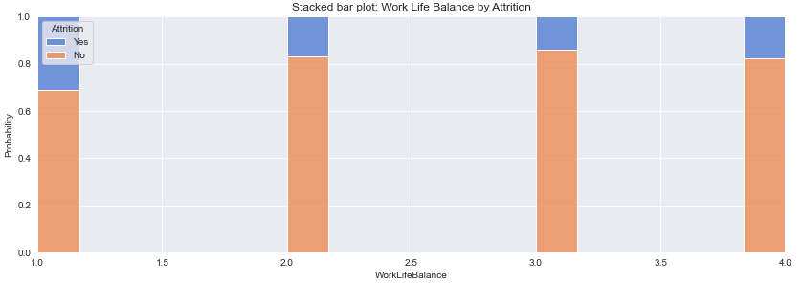
Exploratory Analysis - How is attrition dependent on Work Life Balance
1 'Bad' 2 'Good' 3 'Better' 4 'Best'

Slide 10
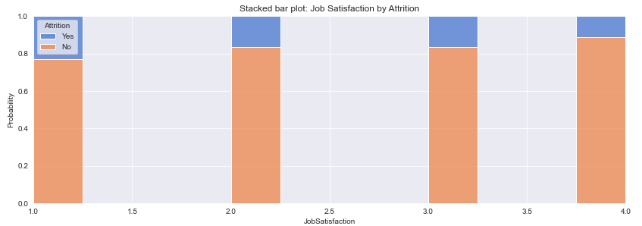
Exploratory Analysis - How is attrition dependent on Job Satisfaction
1 'Low' 2 'Medium' 3 'High' 4 'Very High'

Slide 11
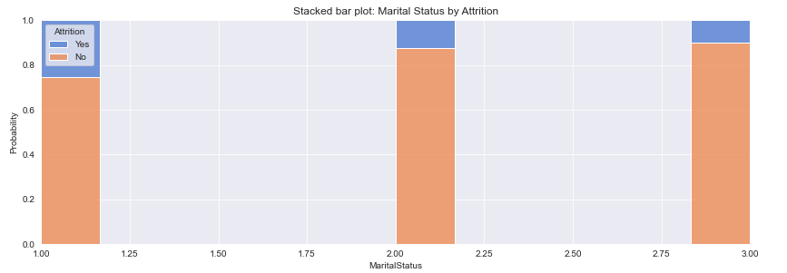
Exploratory Analysis - How is attrition dependent on Marital Status
1 Single’ 2 Married’ 3 Divorced'

Slide 12
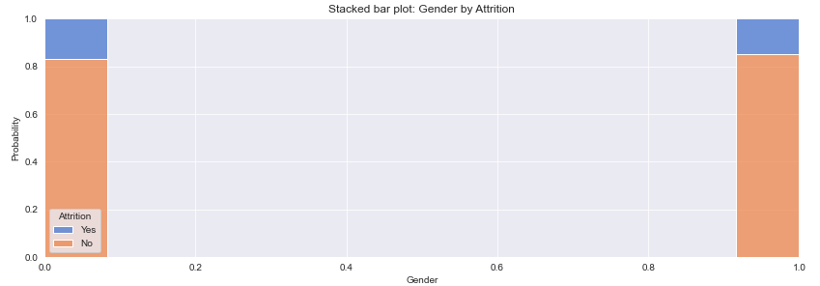
Exploratory Analysis - How is attrition dependent on Gender
1 ‘Female’ 2 ‘Male’
Gender seems to be an irrelevant variable, drop it when train data

Slide 13
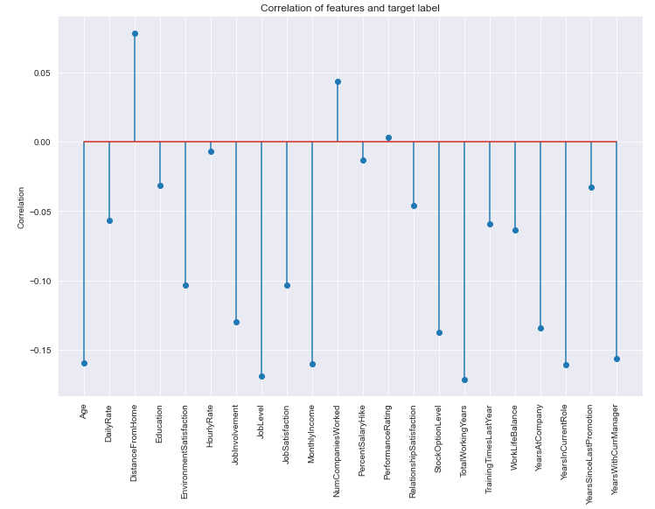
Correlation
Positive correlation:
Distance from home
number of companies worked
Negative correlation:
Age
Job Level
Monthly Income
Total working year
Years in current role
Years with current manager
Job involvement
Stock and option level
Years at company
…

Slide 14
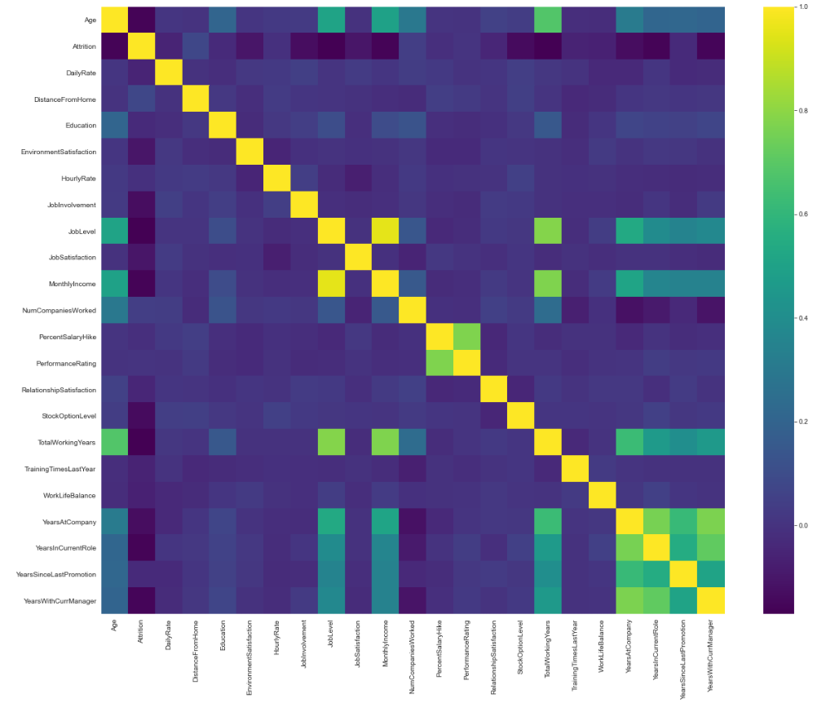
Heat Map - check multicollinearity
Correlation between Monthly Income and Job Level is very high. Need to drop one when train the data.

Slide 15
Next Step…
Feature Selections
Feature Standardization
Model Fitting
- Cross Validation
- Logistic Regression
- Random Forest
- Gradient Boosting
Model Comparison
Conclusions

